Slide 1
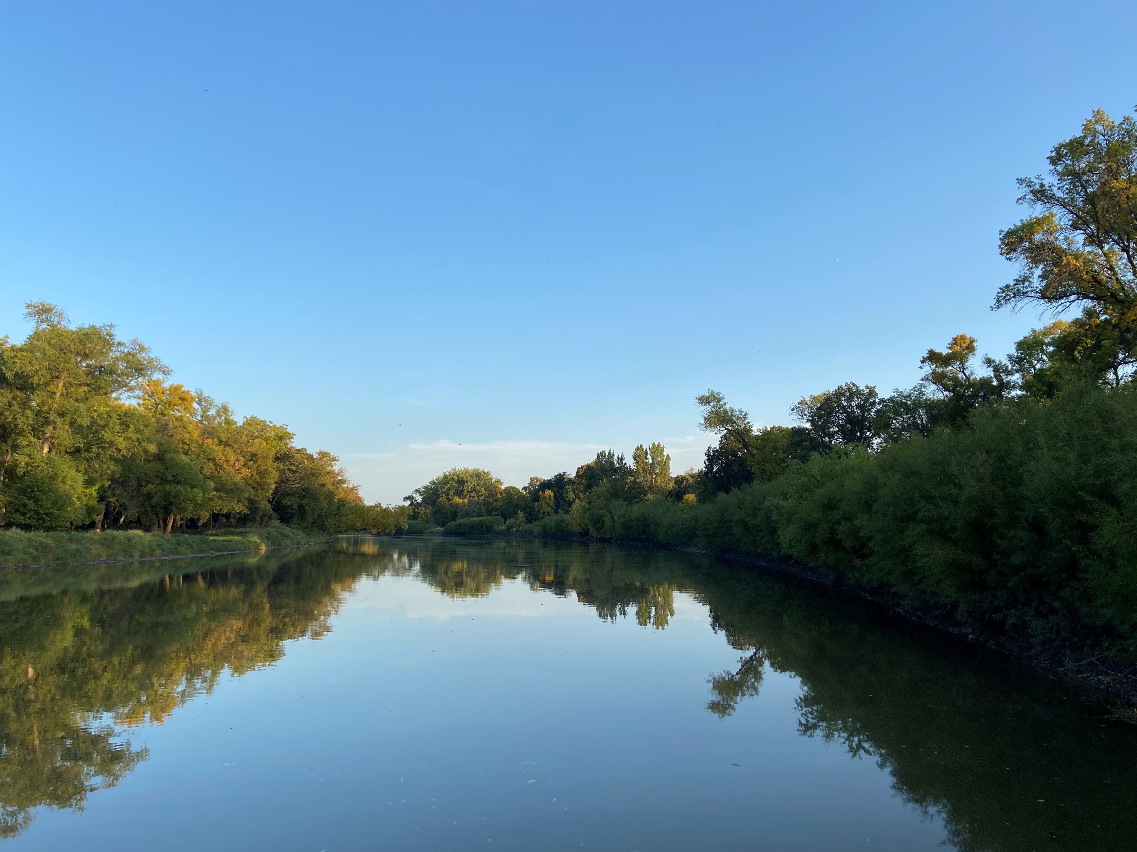


MSUM MS4 Plan
MSUM MS4 Plan

Slide 2
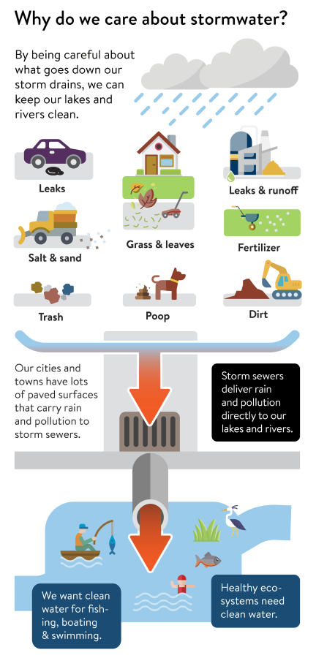
Stormwater
Rain and snow melt run over the many hard surfaces in urbanized areas
  Roads, sidewalks, driveways, parking lots, roof tops, etc.
Picking up pollutants and carry them into storm drains
  Pesticides, fertilizers, oils, metals, road salt, sediment, trash, etc.
Storm drains discharge directly into
  Lakes, rivers, streams, and wetlands
Stormwater runoff is not treated and is a leading source of water pollution

Slide 3

Background
What does MS4 stand for?
  Small Municipal Separate Storm Sewer Systems
Why does MSUM have an MS4?
  MSUM campus is in an urban area that is designated by the Minnesota Pollution Control Agency (MPCA) as an MS4
What is the goal of an MS4 Plan?
  To maintain and improve “waters of the state” through treatment of urban storm water runoff

Slide 4
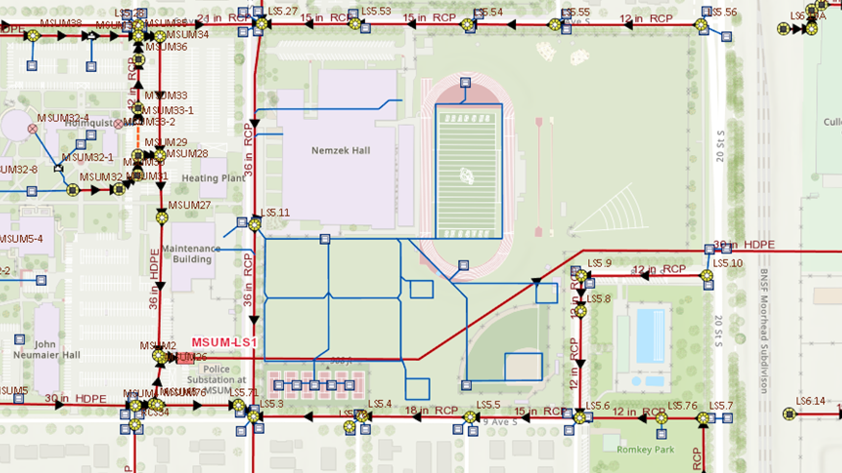
What is an MS4?
A municipal separate storm sewer system (MS4) is a conveyance or system of conveyances (roads with drainage systems, municipal streets, catch basins, curbs, gutters, ditches, man-made channels, storm drains, etc.) that is also:
  owned or operated by a public entity (which can include cities, townships, counties, military bases, hospitals, prison complexes, highway departments, universities, sewer districts, etc.)
  designed or used for collecting or conveying stormwater
  not combined with sewer conveyances
  not part of a publicly owned treatment works

Slide 5
Minnesota MS4s Requirements
What is an MS4?
MS4s in Minnesota must satisfy the requirements of the MS4 general permit if they are at least one of the following:
  Located in an urbanized area and used by a population of 1,000 or more
  Owned by a municipality with a population of 10,000 or more
  Have a population of at least 5,000 and the system discharges to specially classified bodies of water

Slide 6
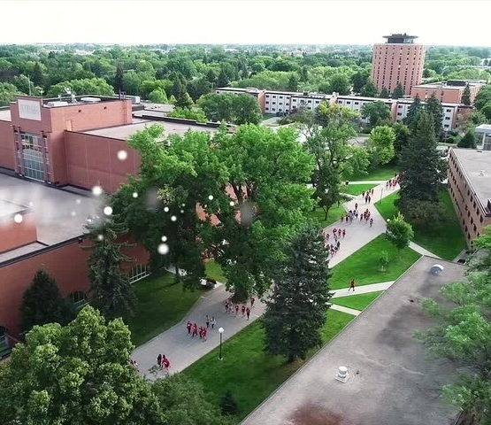
MS4 Permits
Authorize clean stormwater discharges
MS4 General Permit applies to ~250 entities:
  Cities
  Townships
  Watershed districts
  Colleges & universities
  Counties
  Hospitals/medical centers
  MN DOT
  Correctional Facilities
Requires a stormwater pollution prevention program (SWPPP)
  Minimum Control Measure (MCM requirements)
Notes:
https://www.mnstate.edu/about/history-traditions/

Slide 7

What is required by an MS4 Plan?
Implement six minimum control measures (MCMs)
  Public education and outreach
  Public participation and involvement
  Illicit discharge detection and elimination
  Construction site runoff control
  Post construction site runoff control
  Pollution prevention/good housekeeping

Slide 8
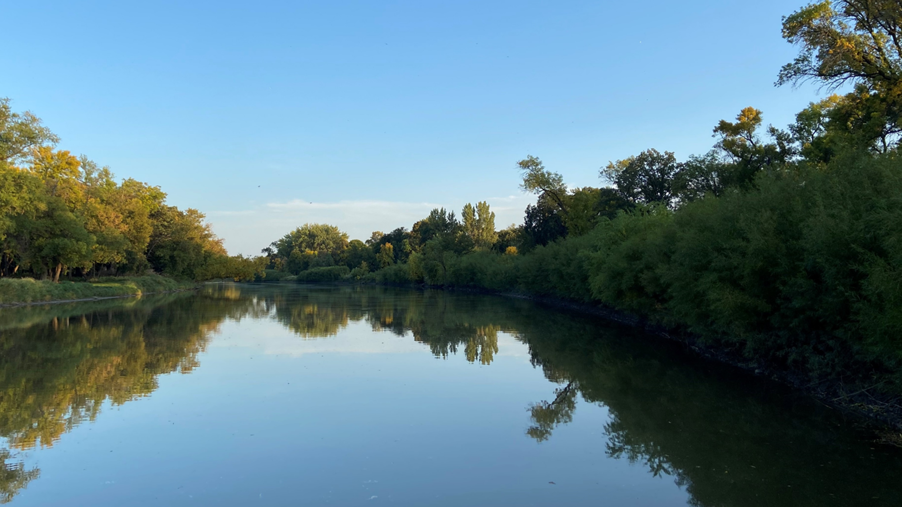
MCM I – Public Education and Outreach
Educate and inform the community on stormwater pollution prevention
  Distribute education materials
  Public participation
  Education program
  Annual public meeting

Slide 9
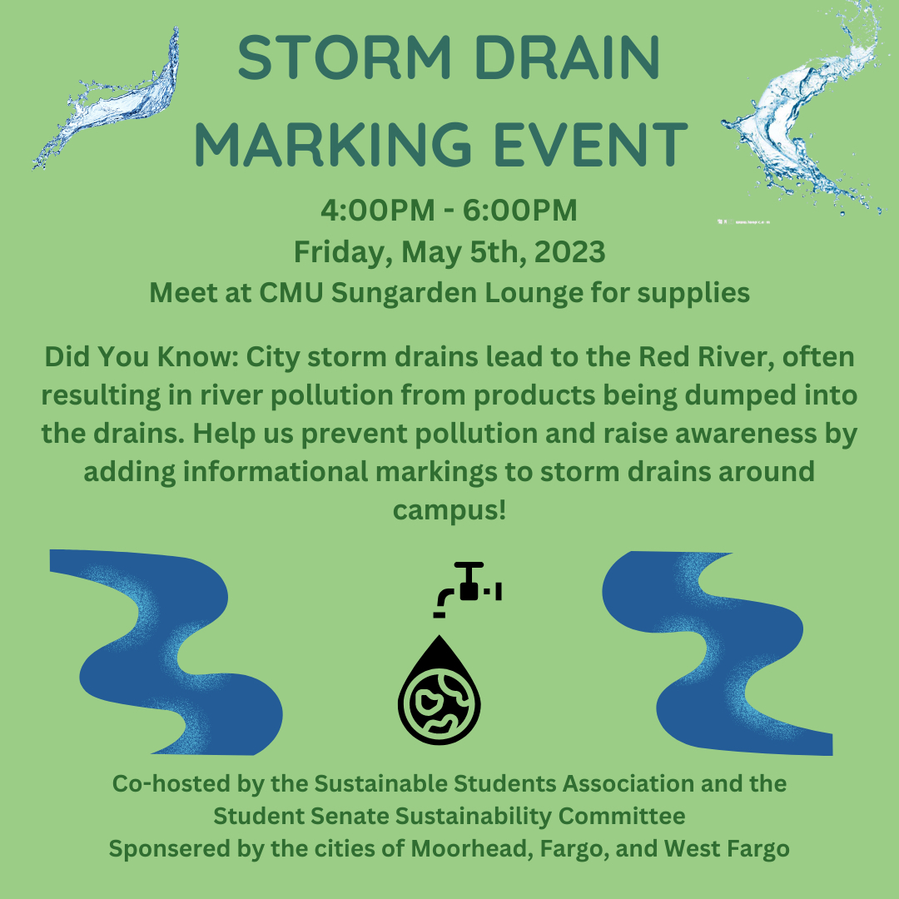
MCM I
MSUM students from the Sustainable Students Association set up a table with educational materials about stormwater pollution at the campus Earth Day event
Students complete inspections of the campus grounds and parking lots
Students inspect and clean around stormwater drains on campus grounds and parking lots and replace any missing or faded stormwater educational decals

Slide 10
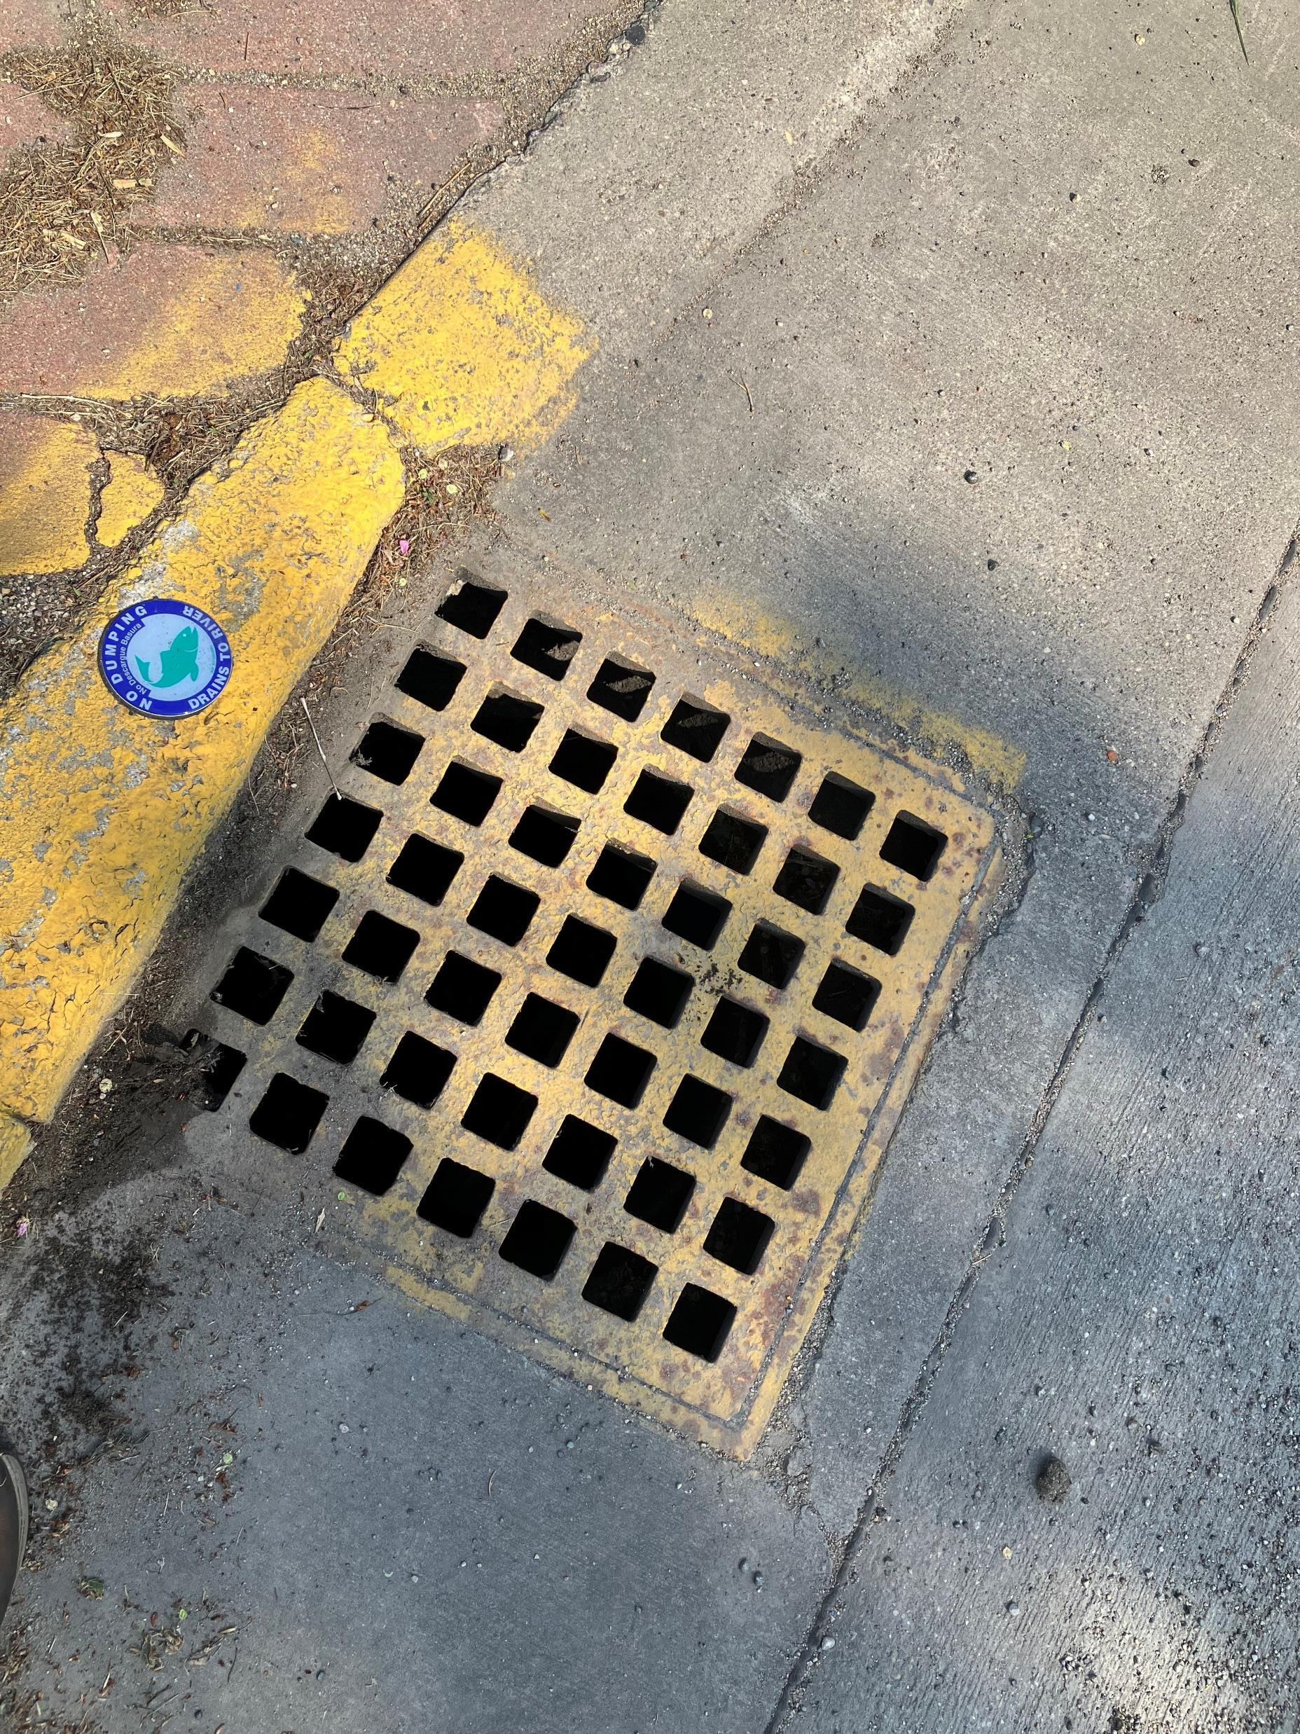

Photo of Storm Drain and emblem
MCM I

Slide 11
MCM II – Public Participation/Involvement
Engage the public to become invested in water quality
  Provide access to the SWPPP and related documents
  Solicit and address public feedback on the stormwater pollution prevention program
Public notice of annual meeting
Consider public input
Annual campus clean-up event

Slide 12
MCM III – Illicit Discharge Detection and Elimination
Detect and eliminate non-stormwater discharges to the MS4
Storm sewer map
Regulatory control program
Detection plan
Public and employee information program

Slide 13
Illicit Discharge
Four Parts to EPA’s definition of an Illicit Discharge:
A storm drain that has measurable flow during dry weather containing pollutants and/or pathogens. A storm drain with measurable flow but no pollutants is a non-illicit discharge.
A discharge that has a unique frequency, composition and mode of entry into the storm drain system.
A discharge may be caused by the interaction of sewage disposal and storm drain systems.
A discharge may be produced from known source areas and operations known as “generating sites.”

Slide 14
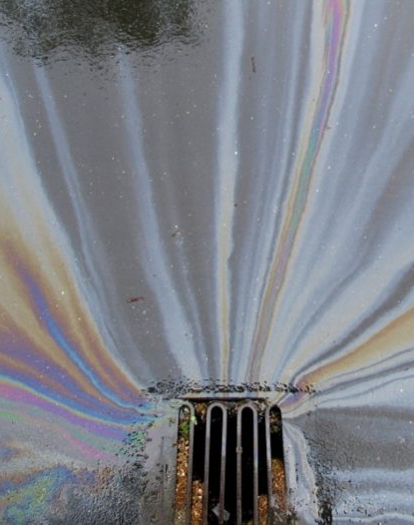
Illicit Discharge examples
Discharge of oil and fuel from vehicles and equipment, to include improper disposal of used products
Fertilizer, pesticides and herbicides that are misapplied or overapplied
Cooking oil and grease
Grass clippings and leaves when intentionally blown into drains
Solvents, cleaning chemicals, paints
Mismanaged/excess road salt
Sediment
Nonresidential vehicle wash water
Septic/sanitary sewer discharges

Slide 15
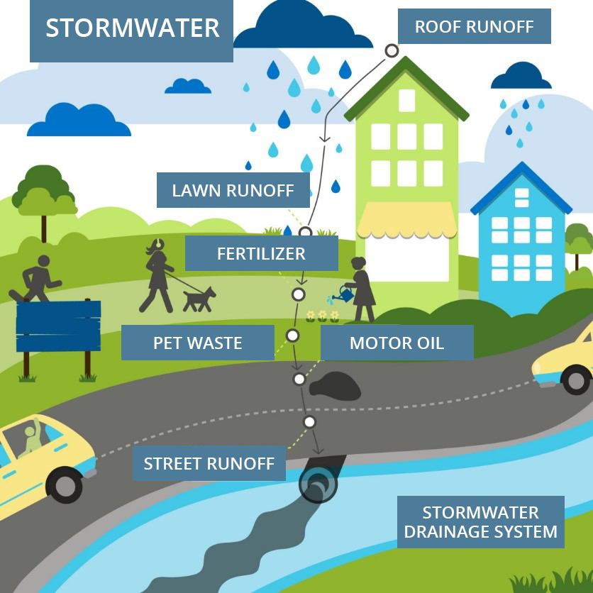
Storm Water Runoff Graphic

Slide 16
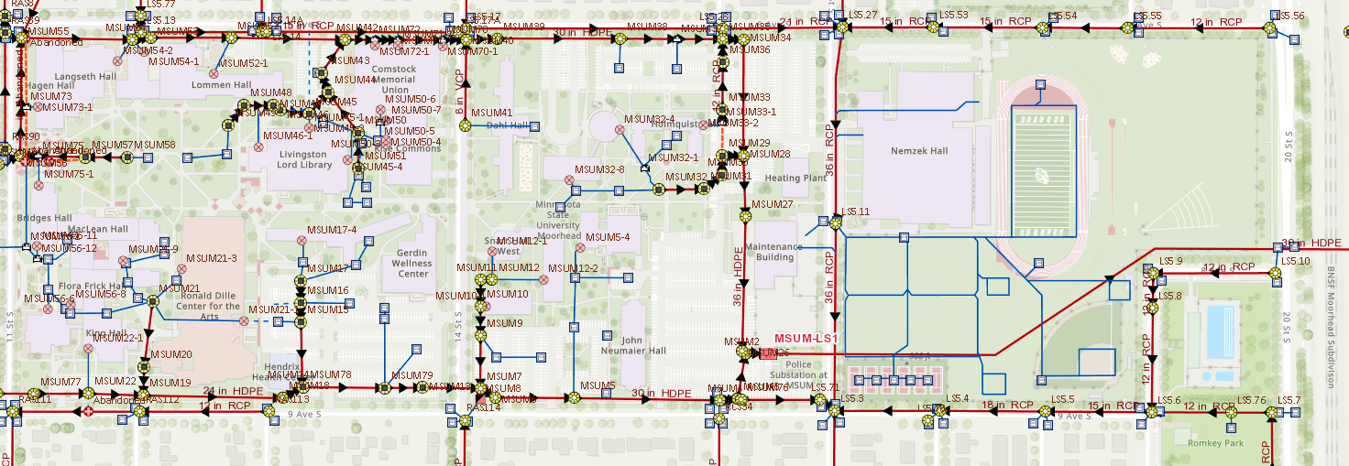
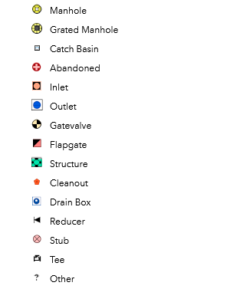
MSUM Storm Sewer System

Slide 17
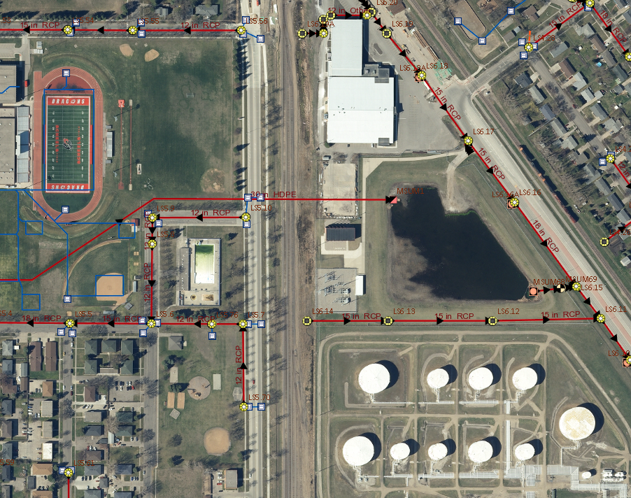
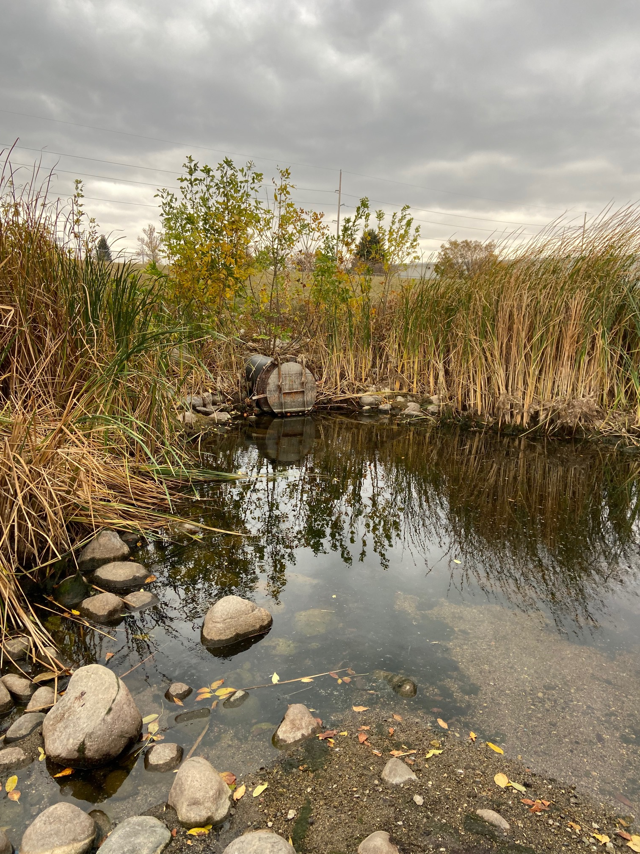
Map and Picture of the East side of MSUM Campus and a holding water area.

Slide 18
MCM IV – Construction Site Storm water run-off control
Construction site erosion and sediment control best management practices (BMPs)
Waste control BMPs
Site plan reviews
Procedure for complaints of storm water non-compliance
Site inspection and enforcement

Slide 19
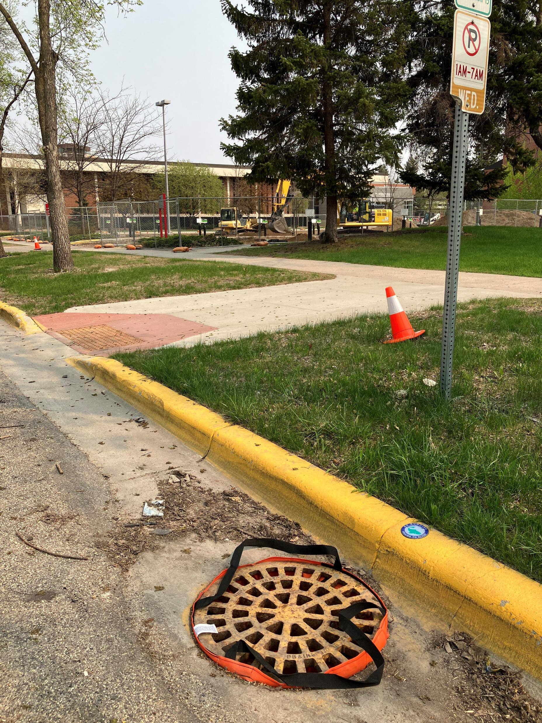
MCM IV
Control sediment and pollutants from entering the MS4

Slide 20
MCM V – Post Construction Site Run-off Control
How stormwater is managed after a construction project is complete
Permittees must have a plan for stormwater runoff long term
Development of structural and non-structural storm water BMPs
  Maintain BMP’s indefinitely
Regulatory mechanisms for compliance

Slide 21
MCM VI – Pollution Prevention/Good Housekeeping
Programs should focus on preventing pollution before it happens
Maintenance program
  Campus vehicle, landscaping, and building maintenance
Street sweeping
Annual inspections
Record keeping
Annual Report
Notes:
Preventing pollutants from entering a waterway is less expensive than restoring a water after it’s been polluted

Slide 22
MCM VI
Prevent pollution to stormwater from campus operations
Address sources of pollution
Assess stormwater ponds
Inspect and maintain outfalls, ponds, BMPs, and facilities
Train employees
  MCM 6 Training

Slide 23
Smart Salting
Stormwater can carry salt used to clear snow and ice from sidewalks and parking lots
Salt helps keep surfaces free from ice but can have a negative effect on the environment
One tsp. of salt contaminates 5 gallons of water – chloride does not degrade
Salt causes damage to infrastructure - sidewalks, roads, and vehicles
Damages both aquatic and terrestrial plants, landscaped areas, and water bodies

Slide 24
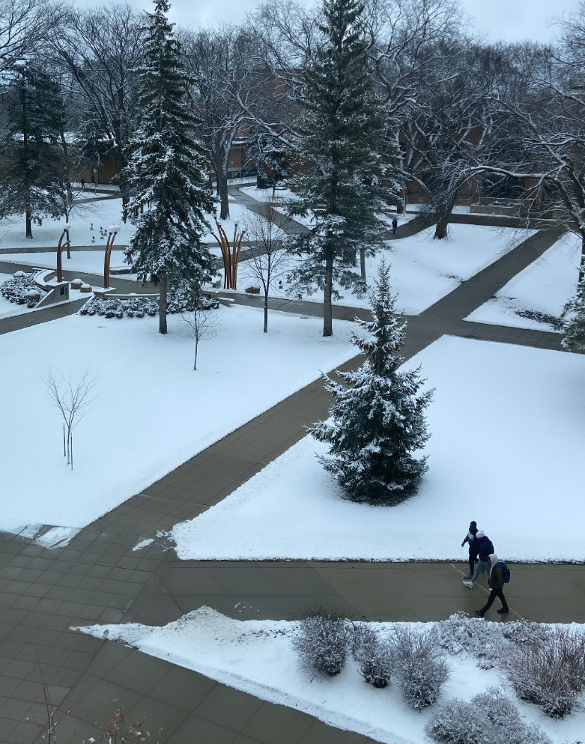
What can you do?
Physically remove as much snow and ice as possible
Use the right materials
  different materials work best at different pavement temps
  15°F is too cold for salt
  While sand does not melt ice, it provides traction
Store materials properly
  Store salt and sand in covered a facility and keep away from storm drains
Apply the correct amount to get the job done
  Sweep up extra salt and sand if visible on dry pavement
  Use less than 4 lbs. (12 oz coffee cup) of salt per 1,000 sq. ft.
Notes:
https://www.lakecountyil.gov/DocumentCenter/View/3045/LessSalt-Equals-Less-Money-Clean-Water-Safe-Conditions--Tips-forEffective-Road-Salting-PDF

Slide 25

Questions?
Please contact:
Thomas French
MSUM Safety Administrator
Thomas.French@mnstate.edu
218-477-2998

