Slide 1
The #betterposter collection…
Original
Presenter
Figure Hero
INSTRUCTIONS:
Choose one of the following templates and edit it.
In addition to the templates there is an example poster that is a hybrid of a #betterposter and a traditional poster.
Be sure to put your presenter ID on your poster.
Delete the templates you do not use and delete the example.
Delete this slide.

Slide 2
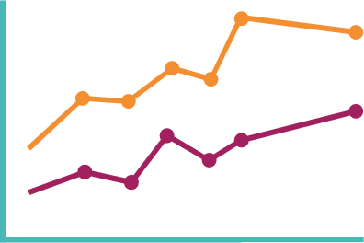
Main finding goes here, translated into plain English. Emphasize the important words.
Non-Cognitive Predictors of Student Success: A Predictive Validity Comparison Between Domestic and International Students
Title: Subtitle
AMMO BAR
Delete this and replace it with your…
Extra Graphs
Extra Correlation tables
Extra Figures
Extra nuance that you’re worried about leaving out.
Keep it messy! This section is just for you.
PRESENTER:
Leeroy Jenkins
Department
BACKGROUND: Who cares? Explain why your study matters in the fastest, most brutal way possible (feel free to add graphics!).
METHODS
Collected [what] from [population]
Tested it with X process.
Illustrate your methods if you can.
Try a flowchart!
RESULTS
Graph/table with essential results only.
All the other correlations in the ammo bar.
Visualize your findings with an image, graphic, or a key figure.
List all authors here
Take a picture to evaluate this poster or go to
https://bit.ly/sac2025-eval
Presentation ID: FILL THIS IN
Notes:
Notes:
In Powerpoint, click View > Guides
Keep text within gutter guides.
Author list: Don’t split names onto two lines (e.g., “Jimmy [break] Smith”). If that happens, use a new line, unless you need the space. Bold the first names of anybody who’s presenting in person.
Intro/methods/result: Do not drop below font size 28, but if you have extra space, jack up the font size until the space is full.
Do not use color in the sidebars except in graphs/figures. It’ll pull attention from the center and slow interpretation for passersby.

Slide 3
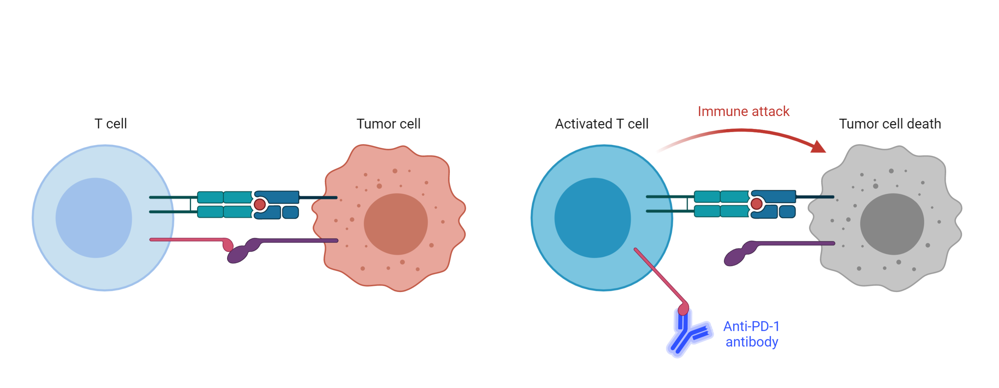
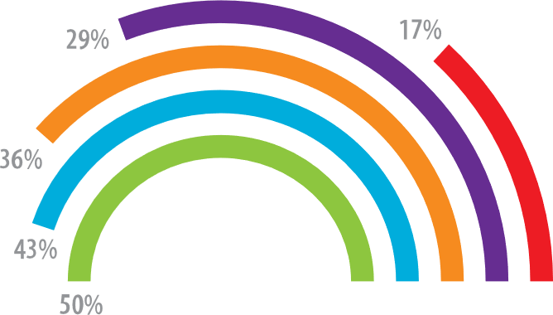
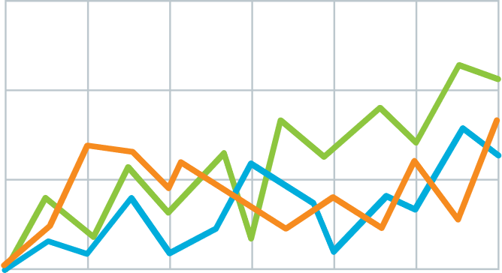
Title: Subtitle
Teach people something cool you learned in 5 seconds as they walk by (or scroll by).
Author1, author2, author3
Department
Method
v
Immune checkpoint inhibits T-cell activation.
Anti-PDF-1 antibodies permit T cell activation.
Explain what the graph shows. Like, spoilers are good.
Quickly explain what the graph shows. Help people think.
v
v
(illustrate your takeaway point)
Take a picture to evaluate this poster or go to
https://bit.ly/sac2025-eval
Presentation ID: FILL THIS IN

Slide 4
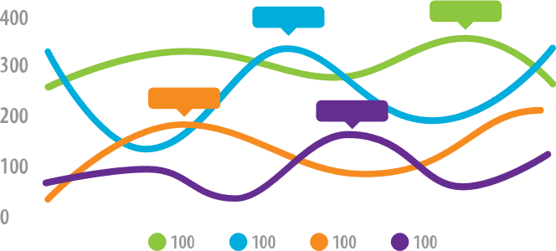
Title: Subtitle
PRESENTER:
Leeroy Jenkins
Department
Teach people something cool you learned in 5 seconds as they walk by.
PRSENTER
Author2, author3, …
Background
Who cares? Explain why your study matters in the fastest, most brutal way possible (feel free to add graphics!).
Methods
N=564 Adult full-time workers
EXPERIMENT GROUP
Given iPod Touch’s with a special app that pings them throughout the day with quick surveys.
Wait list (CONTROL GROUP)
Mood Survey (4x per day)
Participants notified by the iPod at random times to take a short mood survey assessing current mood and attention.
End-of-week Survey
Assessed overall performance for the week.
HLM analysis
Used to relate within-person mood to differences in performance.
Extra results
Assume they already read your punchline, and now include a little extra detail.
Take a picture to evaluate this poster or go to
https://bit.ly/sac2025-eval
Presentation ID: FILL THIS IN

